Slide 1
Relational Algebra (Part-10)
20.9

Slide 2
Contents
Rename

Slide 3
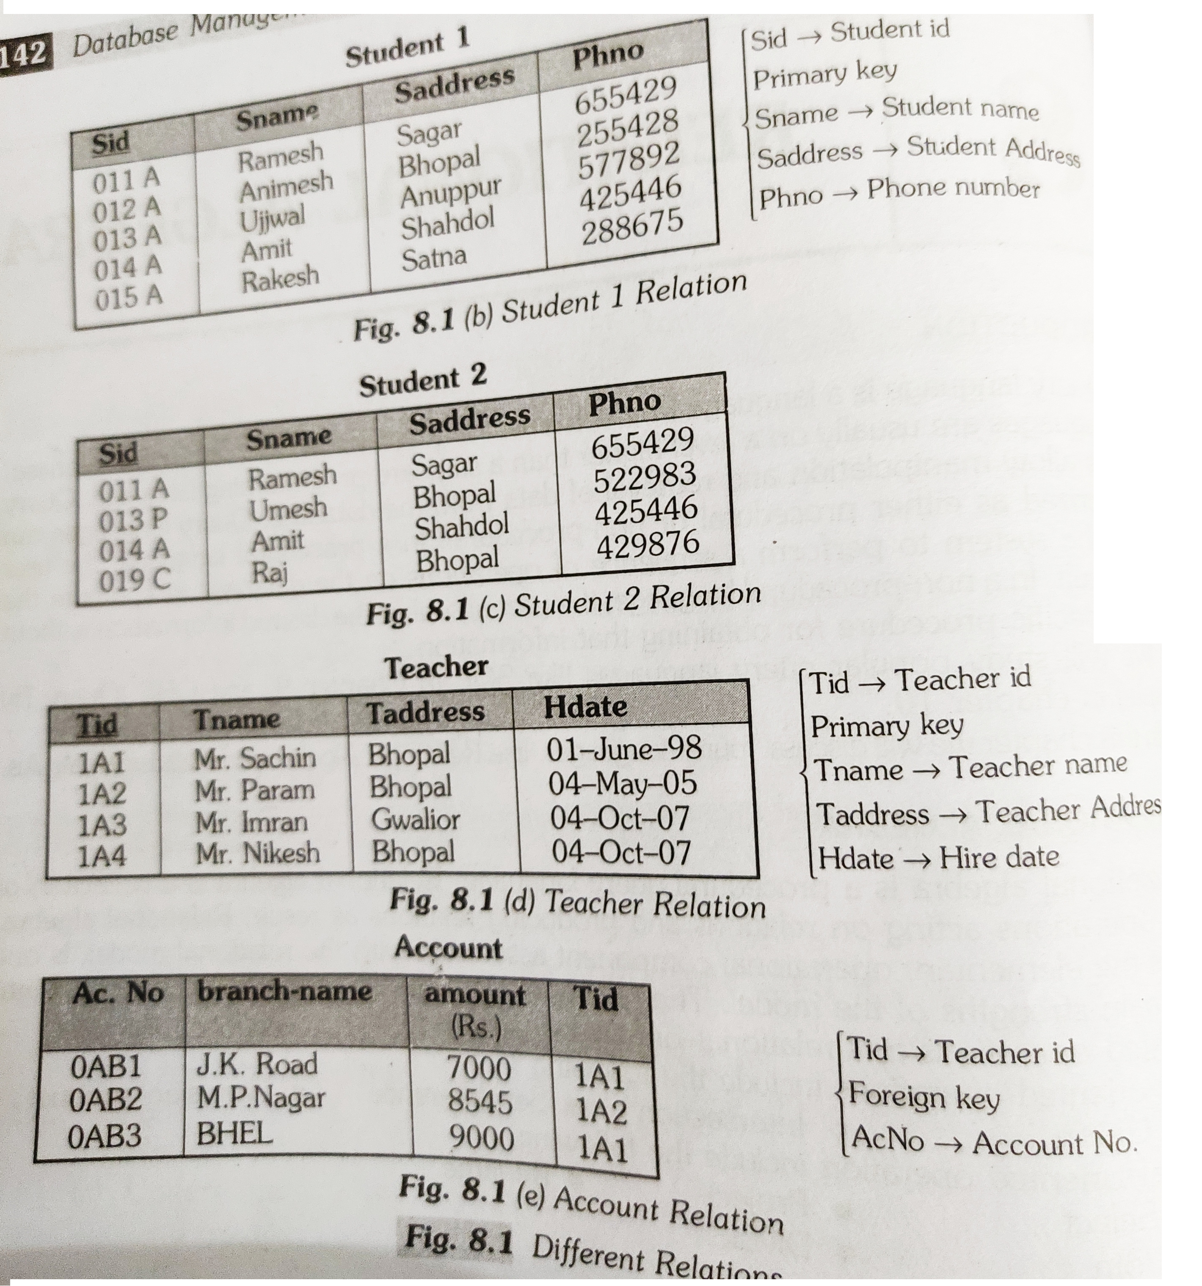
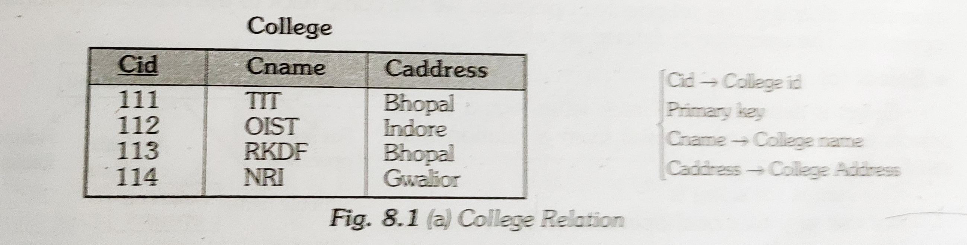
Rename

Slide 4
Rename
The RENAME operation is used to rename the output of a relation.
Sometimes it is simple and suitable to break a complicated sequence of operations and rename it as a relation with different names. Reasons to rename a relation can be many, like –
We may want to save the result of a relational algebra expression as a relation so that we can use it later.
We may want to join a relation with itself, in that case, it becomes too confusing to specify which one of the tables we are talking about, in that case, we rename one of the tables and perform join operations on them.

Slide 5
Rename
ρ X (R)
where the symbol ‘ρ’ is used to denote the RENAME operator and R is the result of the sequence of operation or expression which is saved with the name X.

Slide 6
Rename

Slide 7


